Slide 1
An Enhanced Messenger with Language Translator and Sentiment Analysis
Presented By Under Guidance of
M. Vijay Reddy(16A91A05F4) Mrs. A. Vanathi M.E(Ph.D)
N. Soundarya (16A91A05G1)
M.N.V Ravindra (16A91A05E8)
K. Sai Srujana (16A91A05I3)

Slide 2
ABSTRACT
A Messenger application is a feature or a program on the Internet to communicate directly among Internet users who are online or who were equally using the internet. In the last few years, several Messenger applications came into existence and they are very useful for communication purpose.
It's The Time for the next evolution in the Internet Communication. Bringing together different needs of users and Organization, is the unique vision for The Messenger. Although they’ve been a lot of Messenger apps, the futuristic vison to come up with some new ideas on what we think a Messenger should be, and with whom (for now) they should be interacting with.

Slide 3
ABSTRACT (Continued)
Earlier there was no mode of online communication between users. In big or small organizations communication between users posed a challenge.
There was a requirement to translate these communications from one language to other for further evaluation.
There is no tagging to distinguish a message from other messages.
The idea is to automate the existing Chat applications and make the users to utilize the software so that their valuable time can be saved.

Slide 4
EXISTING SYSTEM
Earlier there was no mode of online communication between users. In big or small organizations communication between users posed a challenge. Let consider a few Most used chat applications and their Limitations
WhatsApp
Group chat for up to 256 people Only
No Poll System to Know Opinions of Group members
No Real-Time Language Translation
Face Book
It’s controlled by Facebook. Privacy issues have been raised in the past and to be fair Facebook was, and still is about monitoring its user behaviour and data collection
No Poll System to Know Opinions of Page Followers
Telegram
Allow Malicious & Phishing URLs to open in Device
Allow to Sending Abusive and Inappropriate Messages
No Real-Time Language Translation
Poll System with Limited Options

Slide 5
Drawbacks of existing chat applications
No Language Translation
No SPAM URL detection
Chat app allows every message whether it is abusive or not
No polling system

Slide 6
Hardware requirements
Processor: Minimum 1GHz. Recommended 2GHz or more.
Memory (RAM): Minimum 3GB.
Microsoft Windows 7/8/10 (32-bit or 64-bit)
3 GB RAM minimum, 8 GB RAM recommended (plus 1 GB for the Android Emulator)
2 GB of available disk space minimum, 4 GB recommended (500 MB for IDE plus 1.5 GB for Android SDK and emulator system image)

Slide 7
Software requirements
Editors
VS code editor
Android Studio
Backend
Node.js
Database
MongoDB
Testers
Socket.io Tester
POSTMAN

Slide 8
Technologies
Ionic
Node.js
MongoDB

Slide 9
PROPOSED SYSTEM
This Chat application will be like any regular chat app ,but with more features like below
Restrict Abusive Messages Using Sentiment Analysis
Real Time Language Translation
Phishing URL Detection
Polls with Live Results
Text to Speech
Text Recognition in Images
URL & Email Detection in Images
Tagging Each Message as IMPORTANT,CONFIDENTIAL,PERSONAL
Drawing Pad

Slide 10
Sentiment Analysis
Sentiment is a Node.js module that uses the AFINN-165 wordlist and Emoji Sentiment Ranking to perform sentiment analysis on arbitrary blocks of input text.
AFINN is a list of words rated for valence with an integer between -5 and +5. Sentiment analysis is performed by cross-checking the string tokens (words, emojis) with the AFINN list and getting their respective scores.
The comparative score is simply: sum of each token / number of tokens.

Slide 11
How Sentiment analysis Works
So for example let's take the following:
I love cats, but I am allergic to them That string results in the following: {
score: 1,
comparative: 0.1111111111111111,
calculation: [ { allergic: -2 }, { love: 3 } ],
tokens: [ 'i', 'love', 'cats', 'but', 'i', 'am', 'allergic', 'to', ’them‘ ],
words: ['allergic', 'love'],
positive: [ 'love'],
negative: ['allergic']
}

Slide 12
Naive Bayes algorithm
Naive Bayes algorithm is the algorithm that learns the probability of an object with certain features belonging to a particular group/class. In short, it is a probabilistic classifier.
The Naive Bayes algorithm is called “naive” because it makes the assumption that the occurrence of a certain feature is independent of the occurrence of other features.
For instance, if you are trying to identify a fruit based on its color, shape, and taste, then an orange colored, spherical, and tangy fruit would most likely be an orange. Even if these features depend on each other or on the presence of the other features, all of these properties individually contribute to the probability that this fruit is an orange and that is why it is known as “naive.”

Slide 13
Micro Services
Micro services also known as the micro service architecture is an architectural style that structures an application as a collection .
The Micro service architecture enables the rapid, frequent and reliable delivery of large, complex applications. It also enables an development team to evolve its technology stack
Services can be implemented using different programming languages, databases, hardware and software environment, depending on what fits best
Services in a Micro service architecture are independently deployable.

Slide 14
Micro Services in The App
Socket micro service : listening Socket Events
Backend micro service: Services like login ,get messages,etc..
Uploader micro service: On Uploading a file it save file in Cloud and gave acknowledgement with URL
Translater micro service : make request to Microsoft azure translation Service for translating the text
Phishing Url microservice : make request Phising tank to confirm urls in message are phising urls or not

Slide 15
Modules
Following Modules available in both One-One Chat and Group Chat
Chat Communication with Sentiment Analysis
Language Translation
URL Spam Checker
File Upload

Slide 16
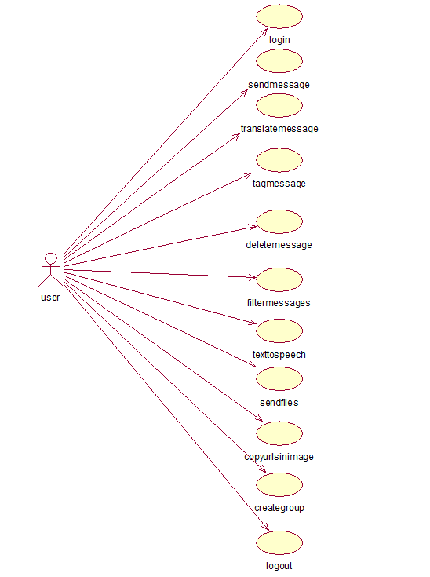
Use Case Diagram for User

Slide 17
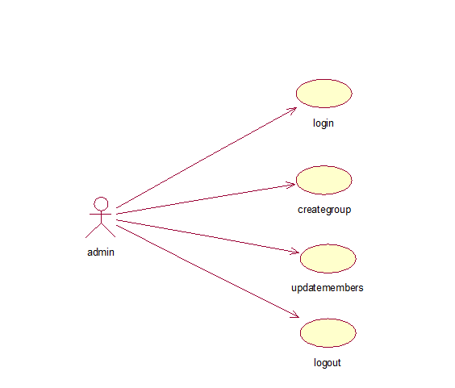
Use Case Diagram for Admin

Slide 18
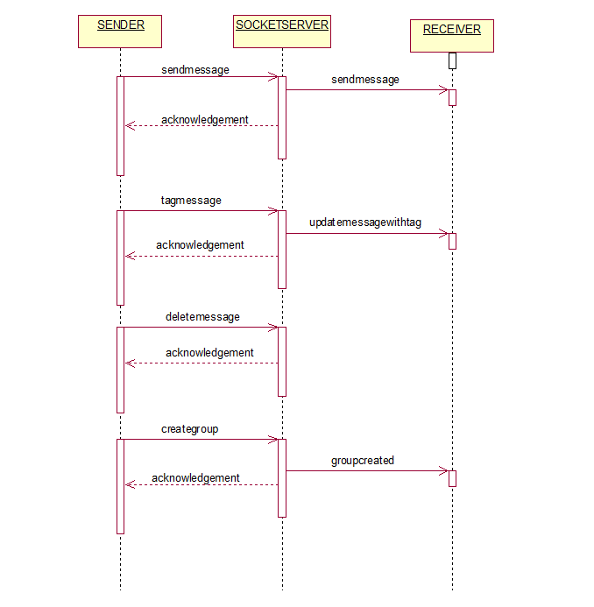
Sequence Diagram for Chat

Slide 19
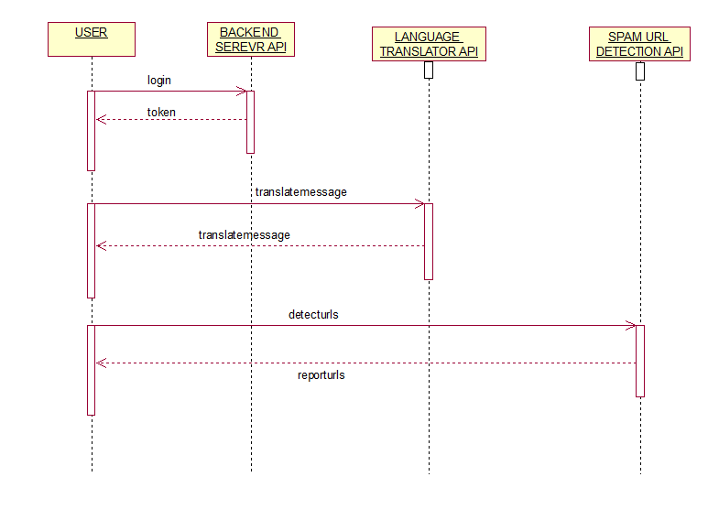
Sequence Diagram for Micro Services

Slide 20
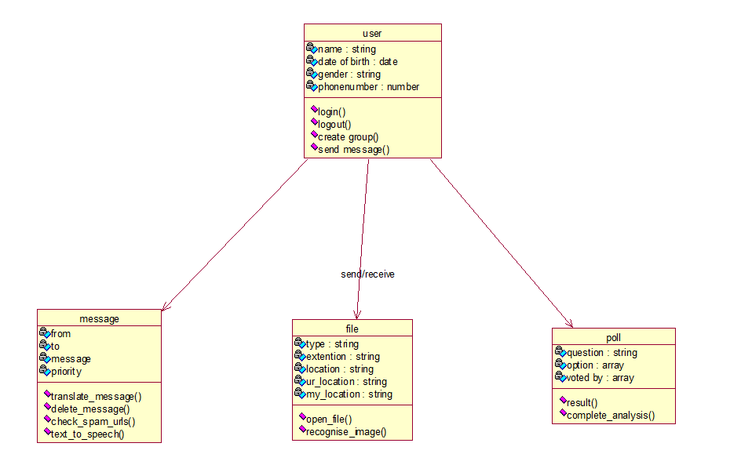
Class Diagram

Slide 21
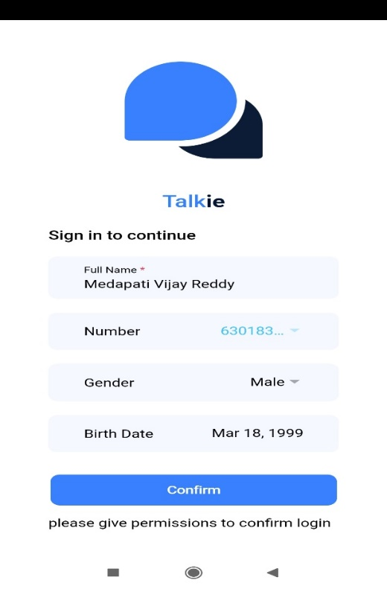
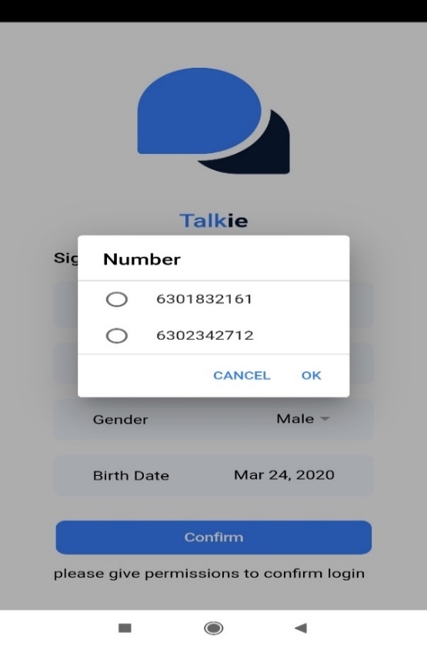
Login page

Slide 22
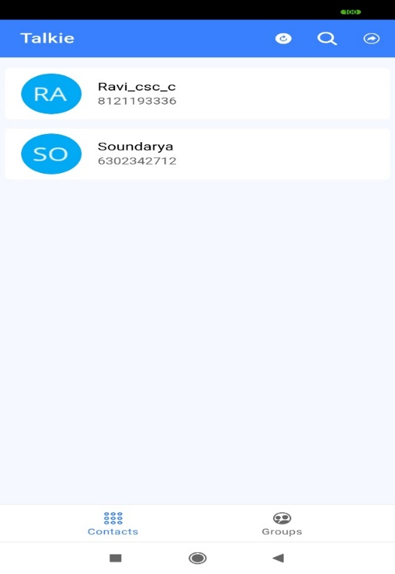
Contacts Page

Slide 23
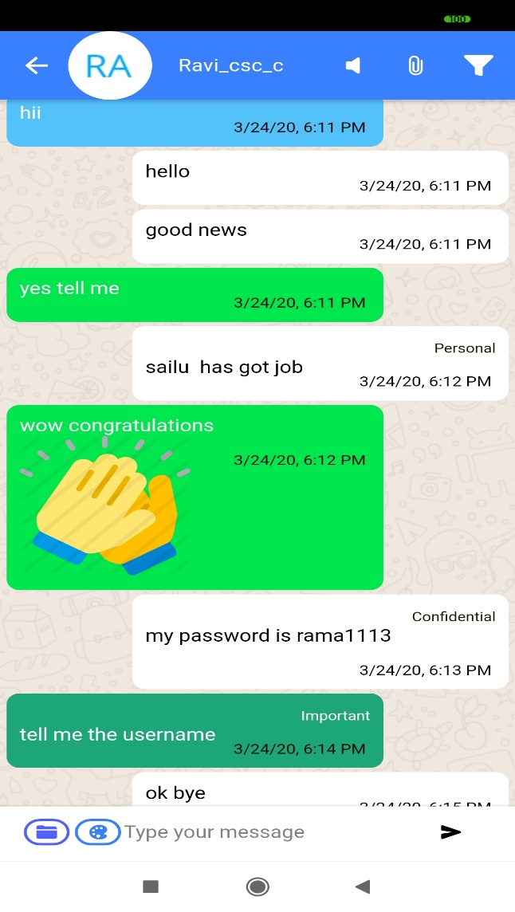
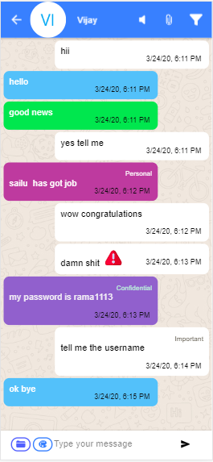
Chat Interface

Slide 24
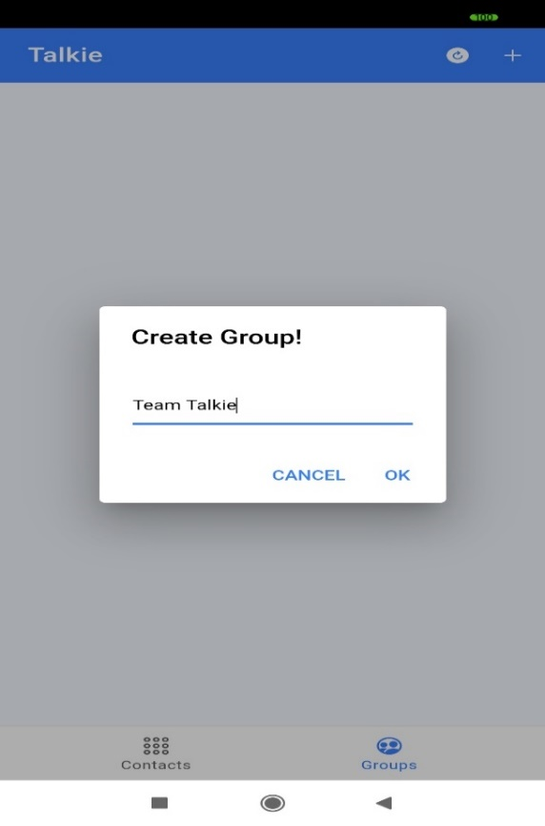
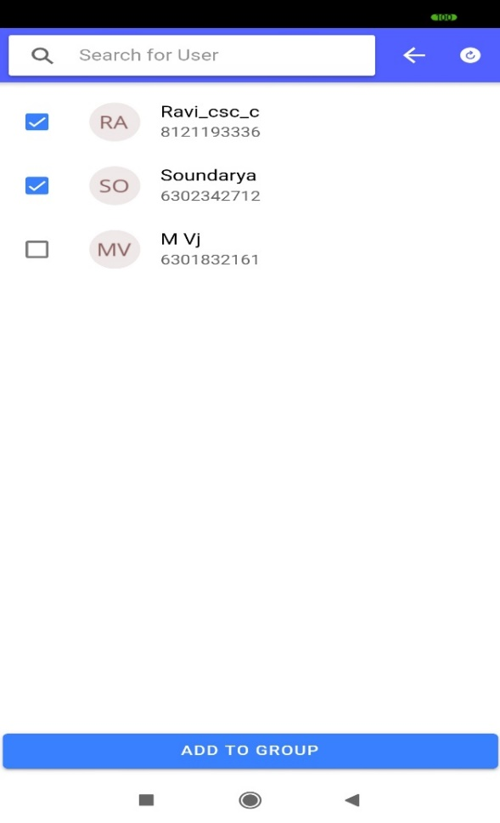
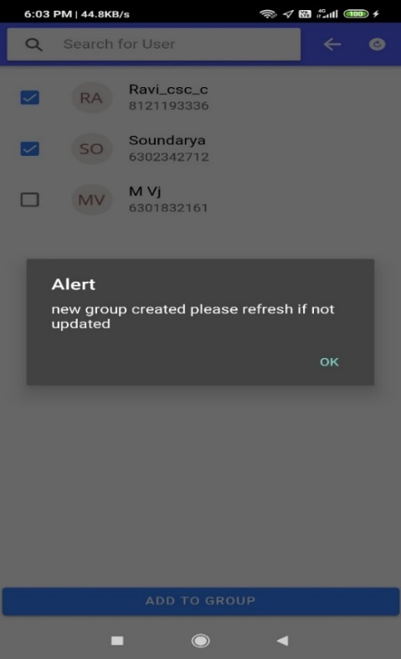
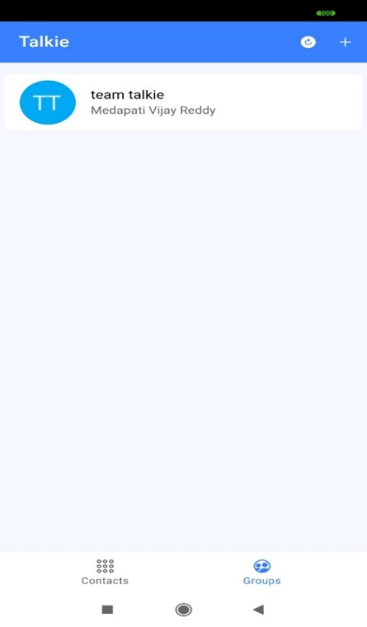
Group Creation

Slide 25
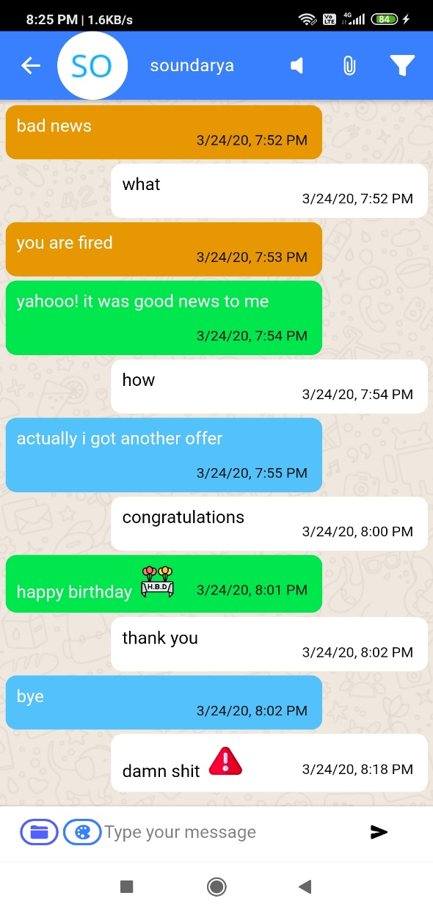
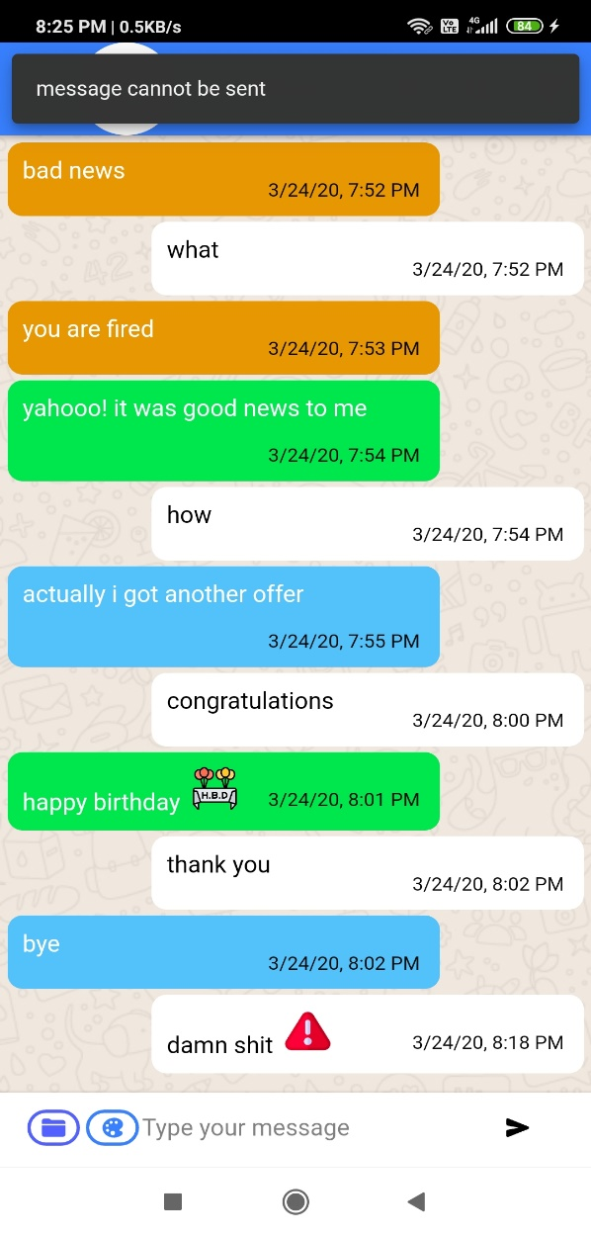
Abusive message restriction

Slide 26
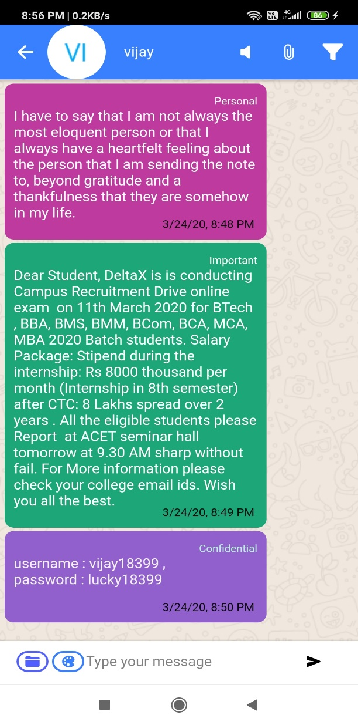
Message Tagging

Slide 27
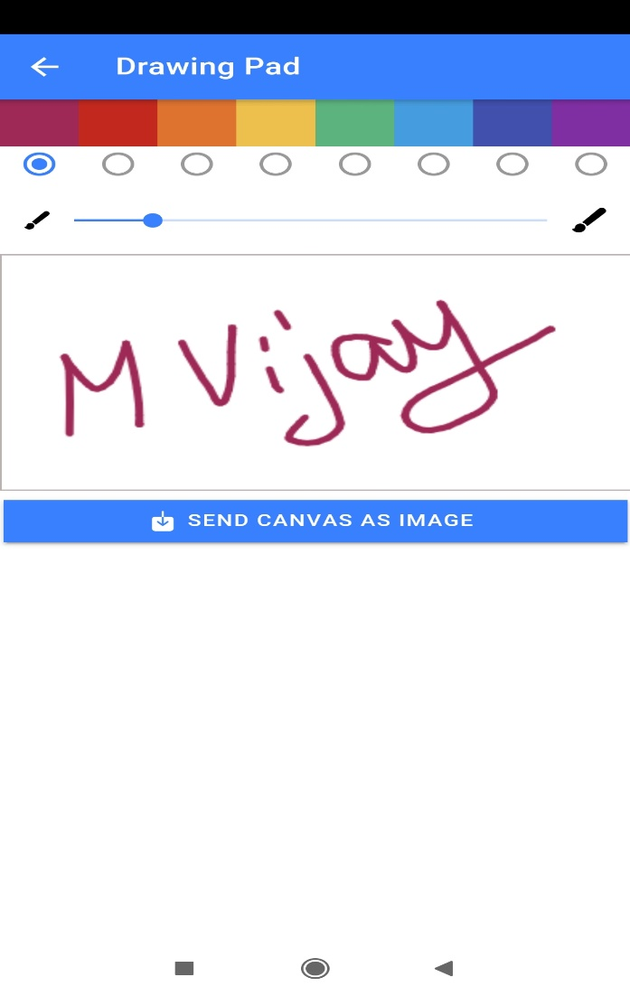
Drawing Pad

Slide 28
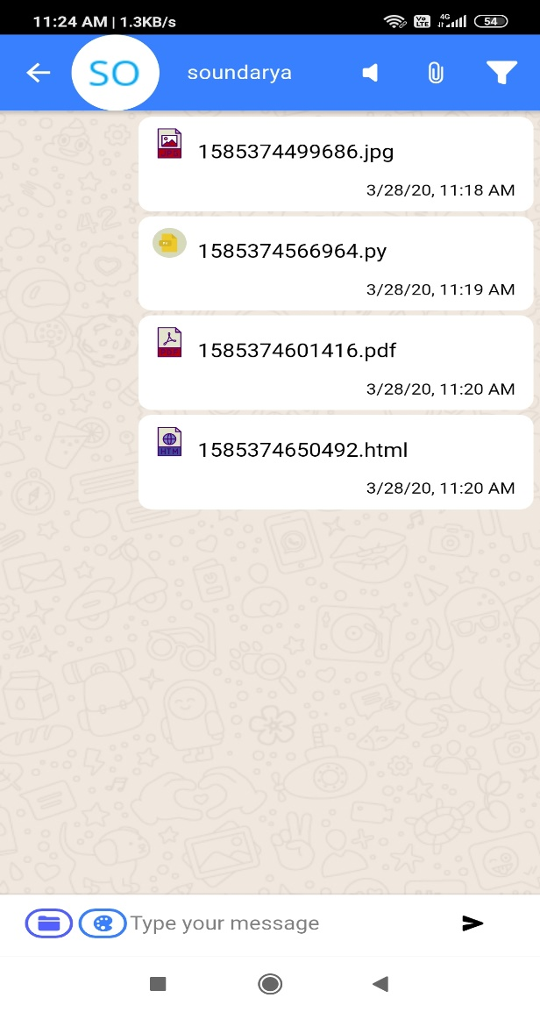
File type Indication

Slide 29
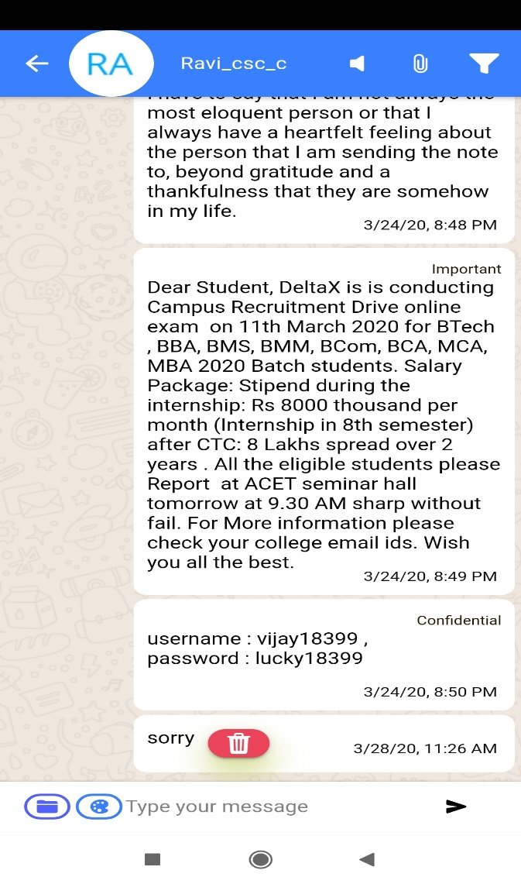
Delete for Every One

Slide 30
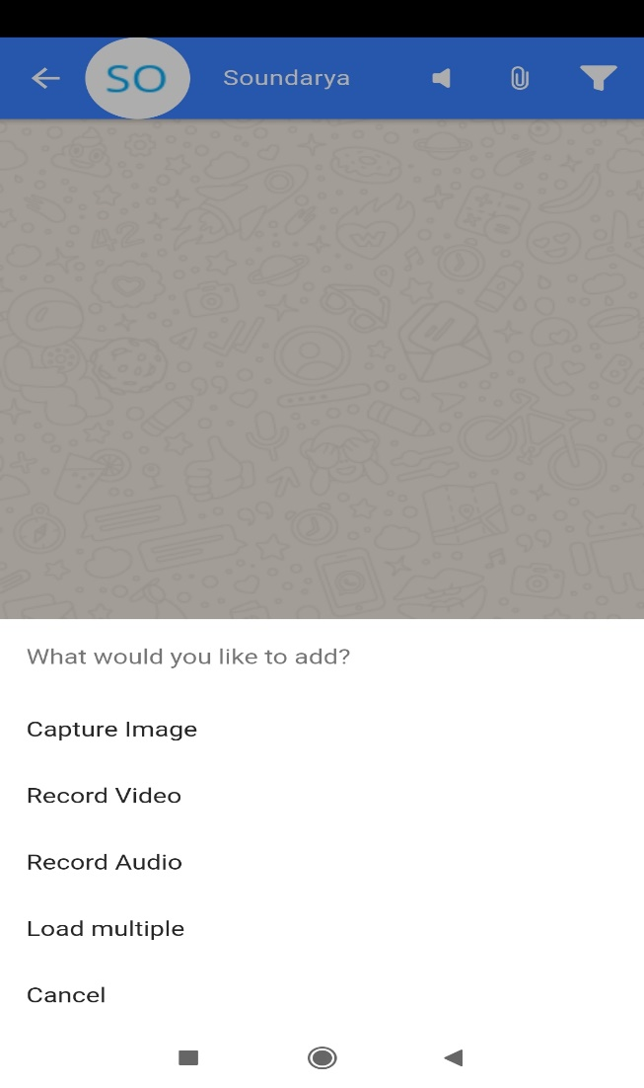
Capture Media

Slide 31
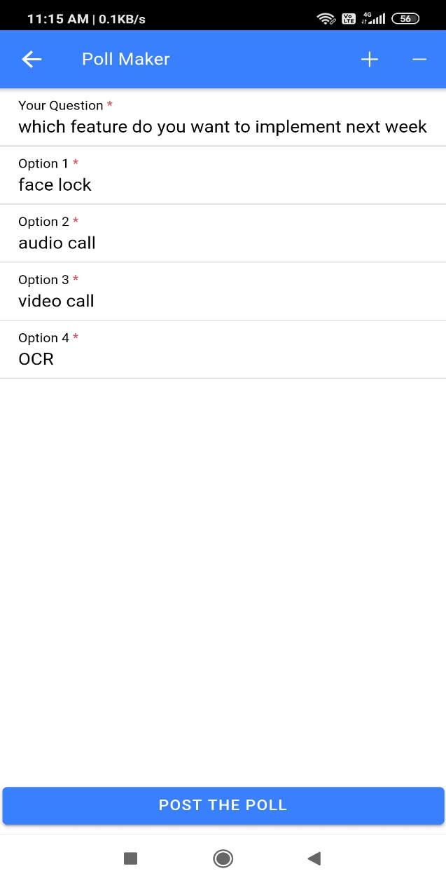
Poll Maker

Slide 32
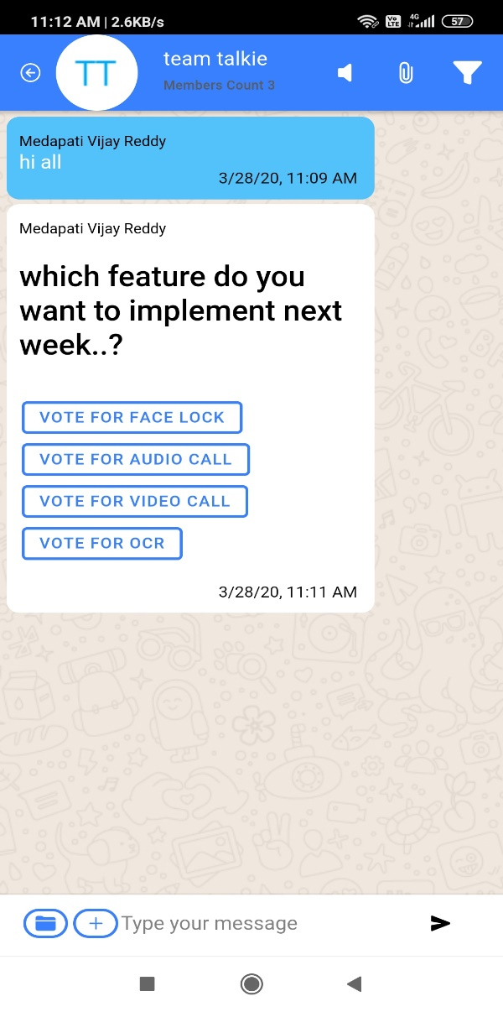
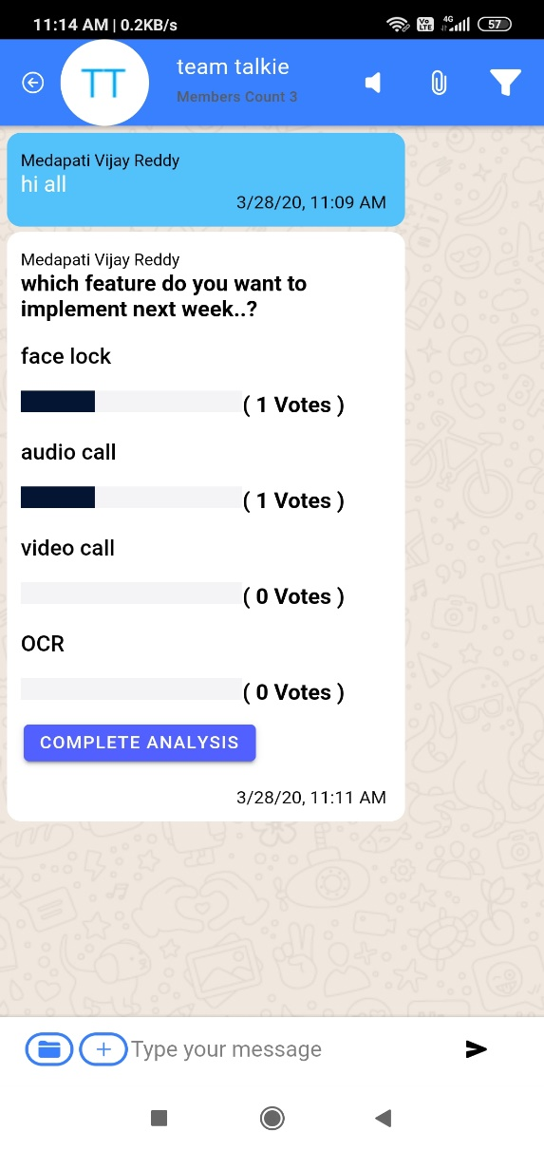
Poll & Result

Slide 33
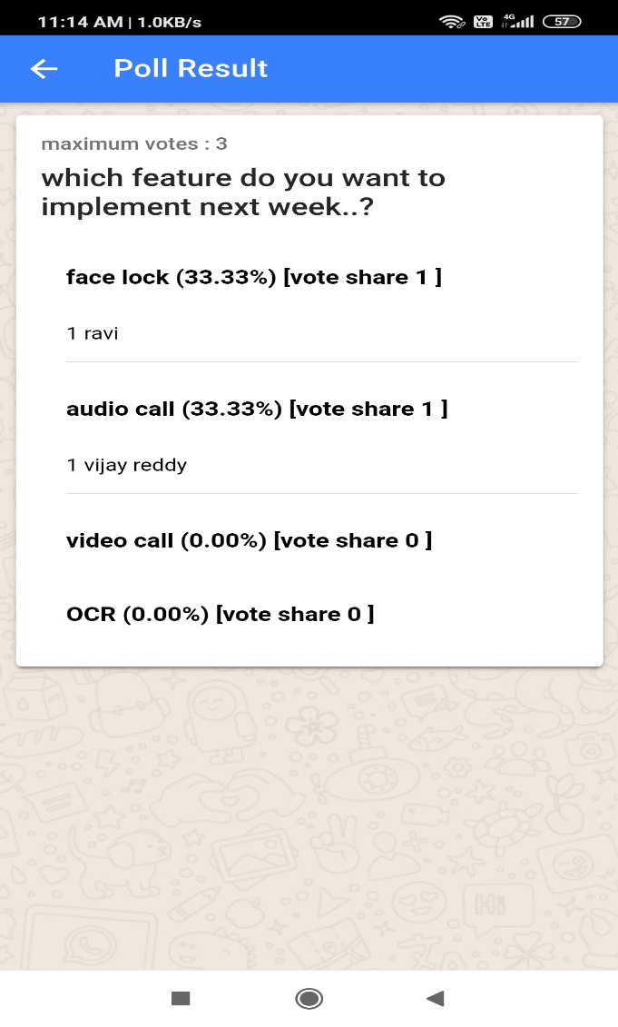
Complete Poll Result

Slide 34
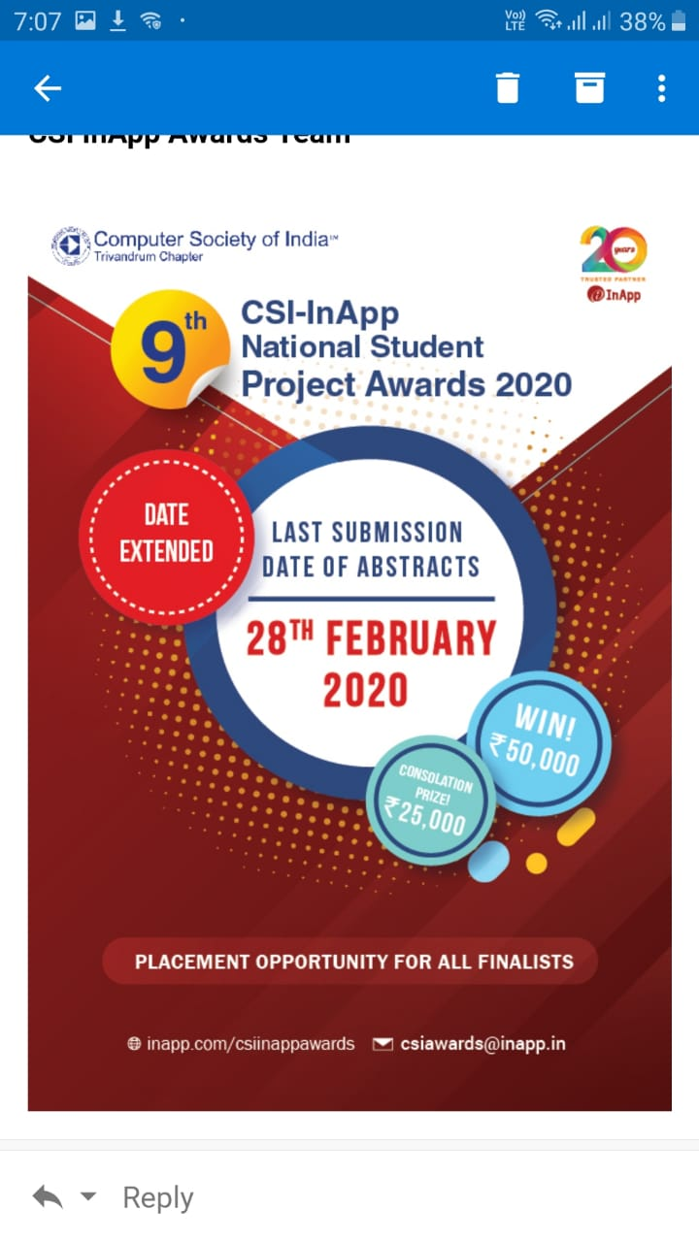
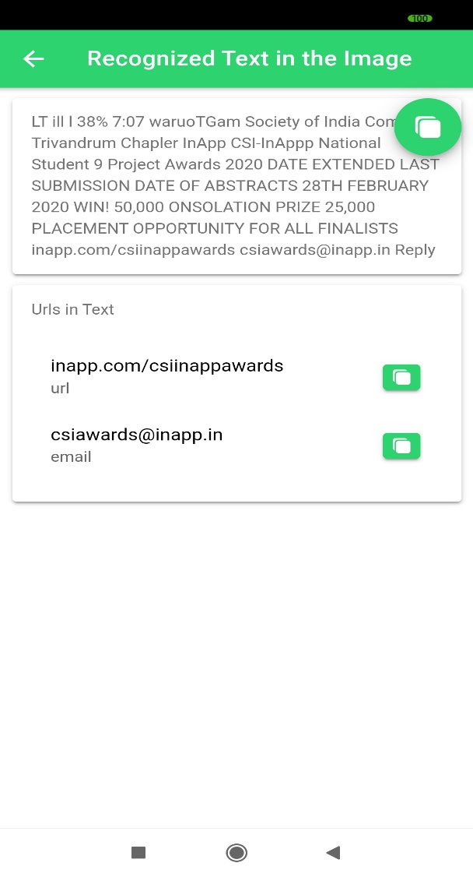
OCR Result Page

Slide 35
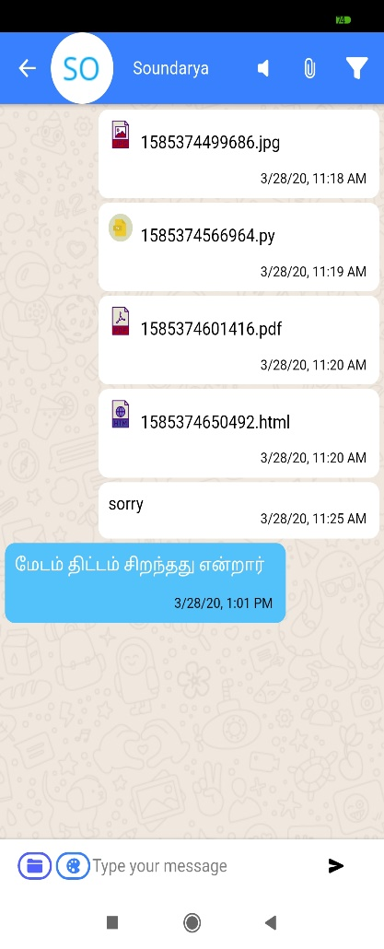
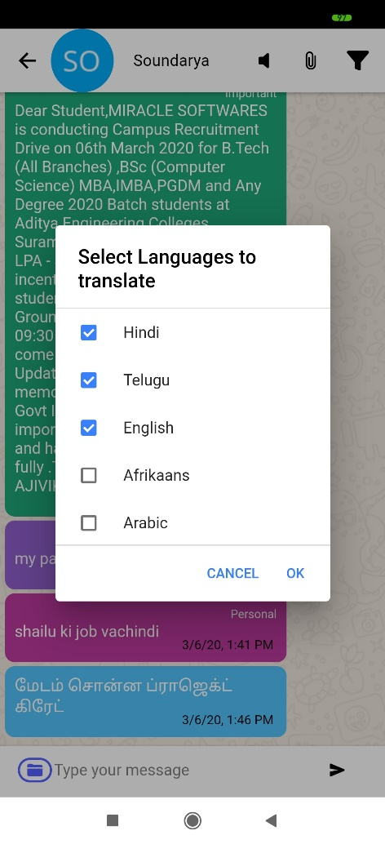
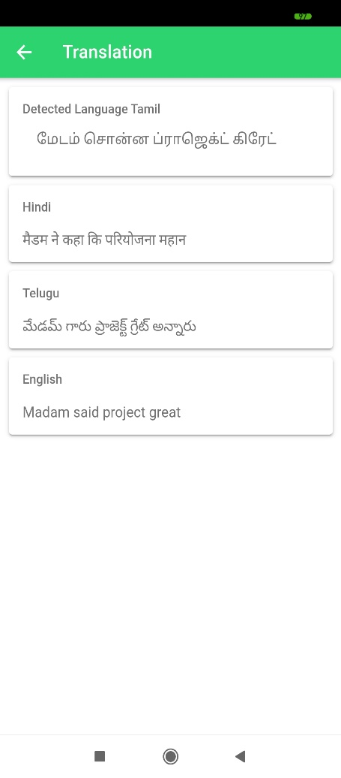
Translation

Slide 36
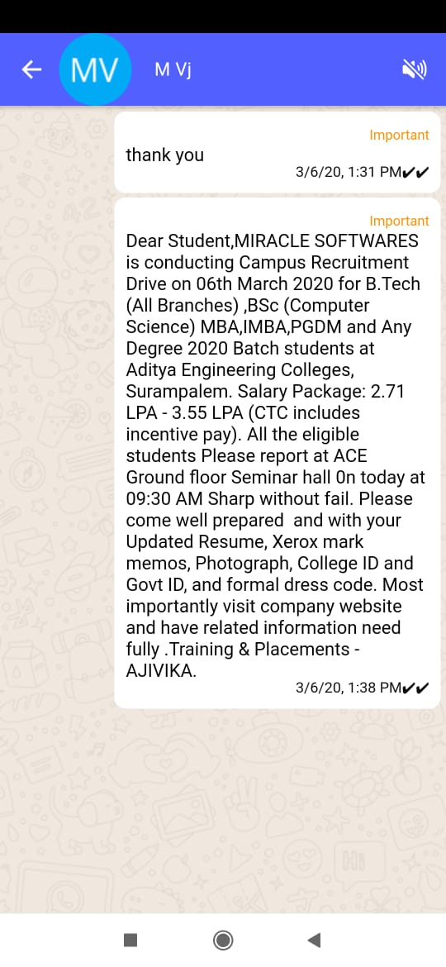
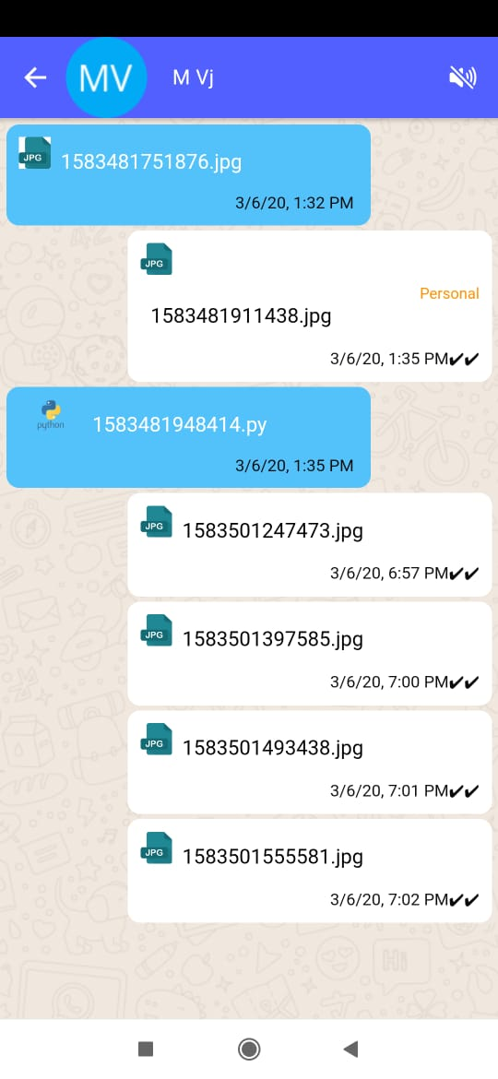
Message filter

Slide 37
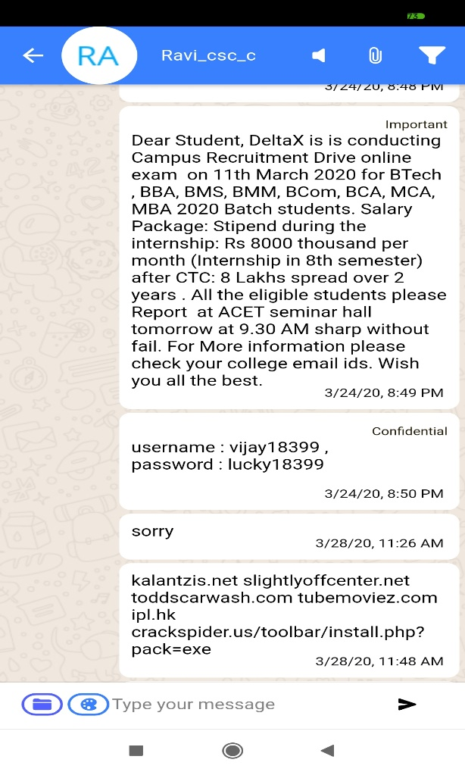
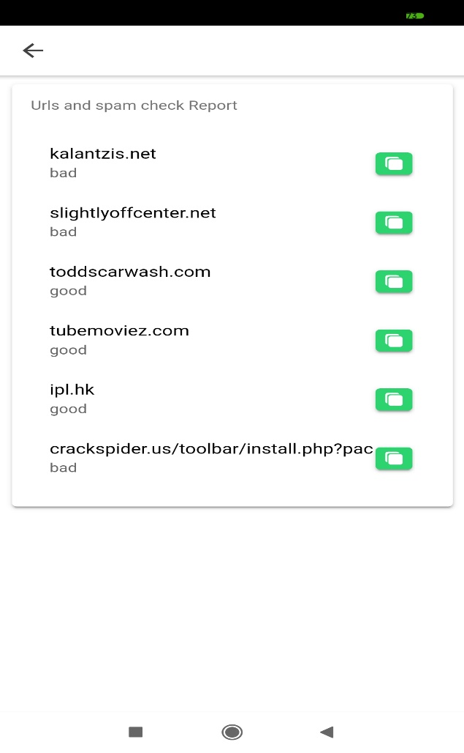
SPAM Report

Slide 38
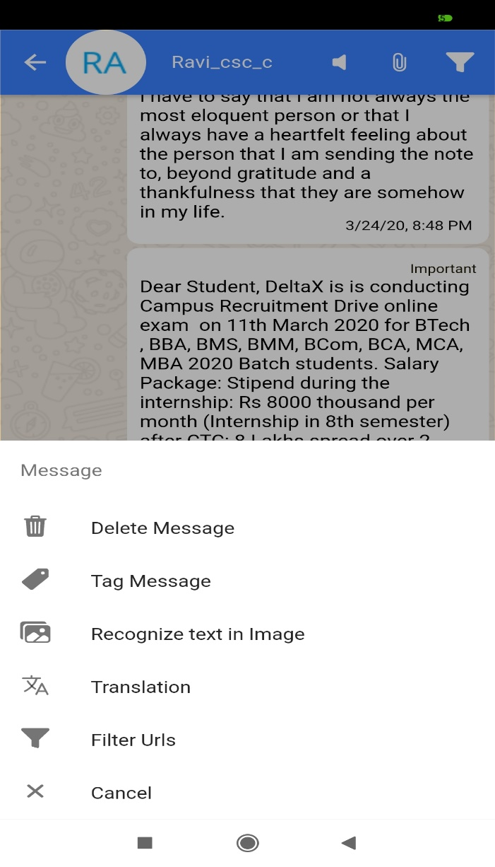
Message Options

Slide 39
Conclusion
Chatting is a very common used application among users. General users use instant messaging services to communicate with other individual users. In our project, we have provided with many enhanced features for a chat application. The features like sentiment analysis, language translator, spam detection, message tagging, text recognition in image plays a major role.
The Chat App protects user and device from various things like Abusive messages, Phishing Attacks and Malicious URLs. Each message received can be translated to more than 60 languages using 3rd party Service namely Microsoft Azure Cognitive service. The chat application is so aimed that the people could have a better experience of chatting. It has the potential to attract more and more users to interact and connect.
Scope
Sentiment Analysis With Multiple Language Support
Instant URL Classification
Fingerprint Lock

Slide 40
References:
[1] Chatting Application with Real Time Translation Nikhil Chaudhari 1, SushmaShinkar 2, Priyanka Pagare Bachelor of Engineering, Computer Engineering Department, Sanghavi college of Engineering , Maharashtra, India
[2] Sentiment Analysis of Chat Application Swanand Joshi, Amey Ruikar Department of Information and Technology Pune Institute of Computer and Technology Pune, India
Websites referred:
https://devdactic.com/ionic-realtime-socket-io/
https://ionicframework.com/
https://docs.mongodb.com/

Slide 41
Any Queries ?

Slide 42
Thank you ?

